Slide 1
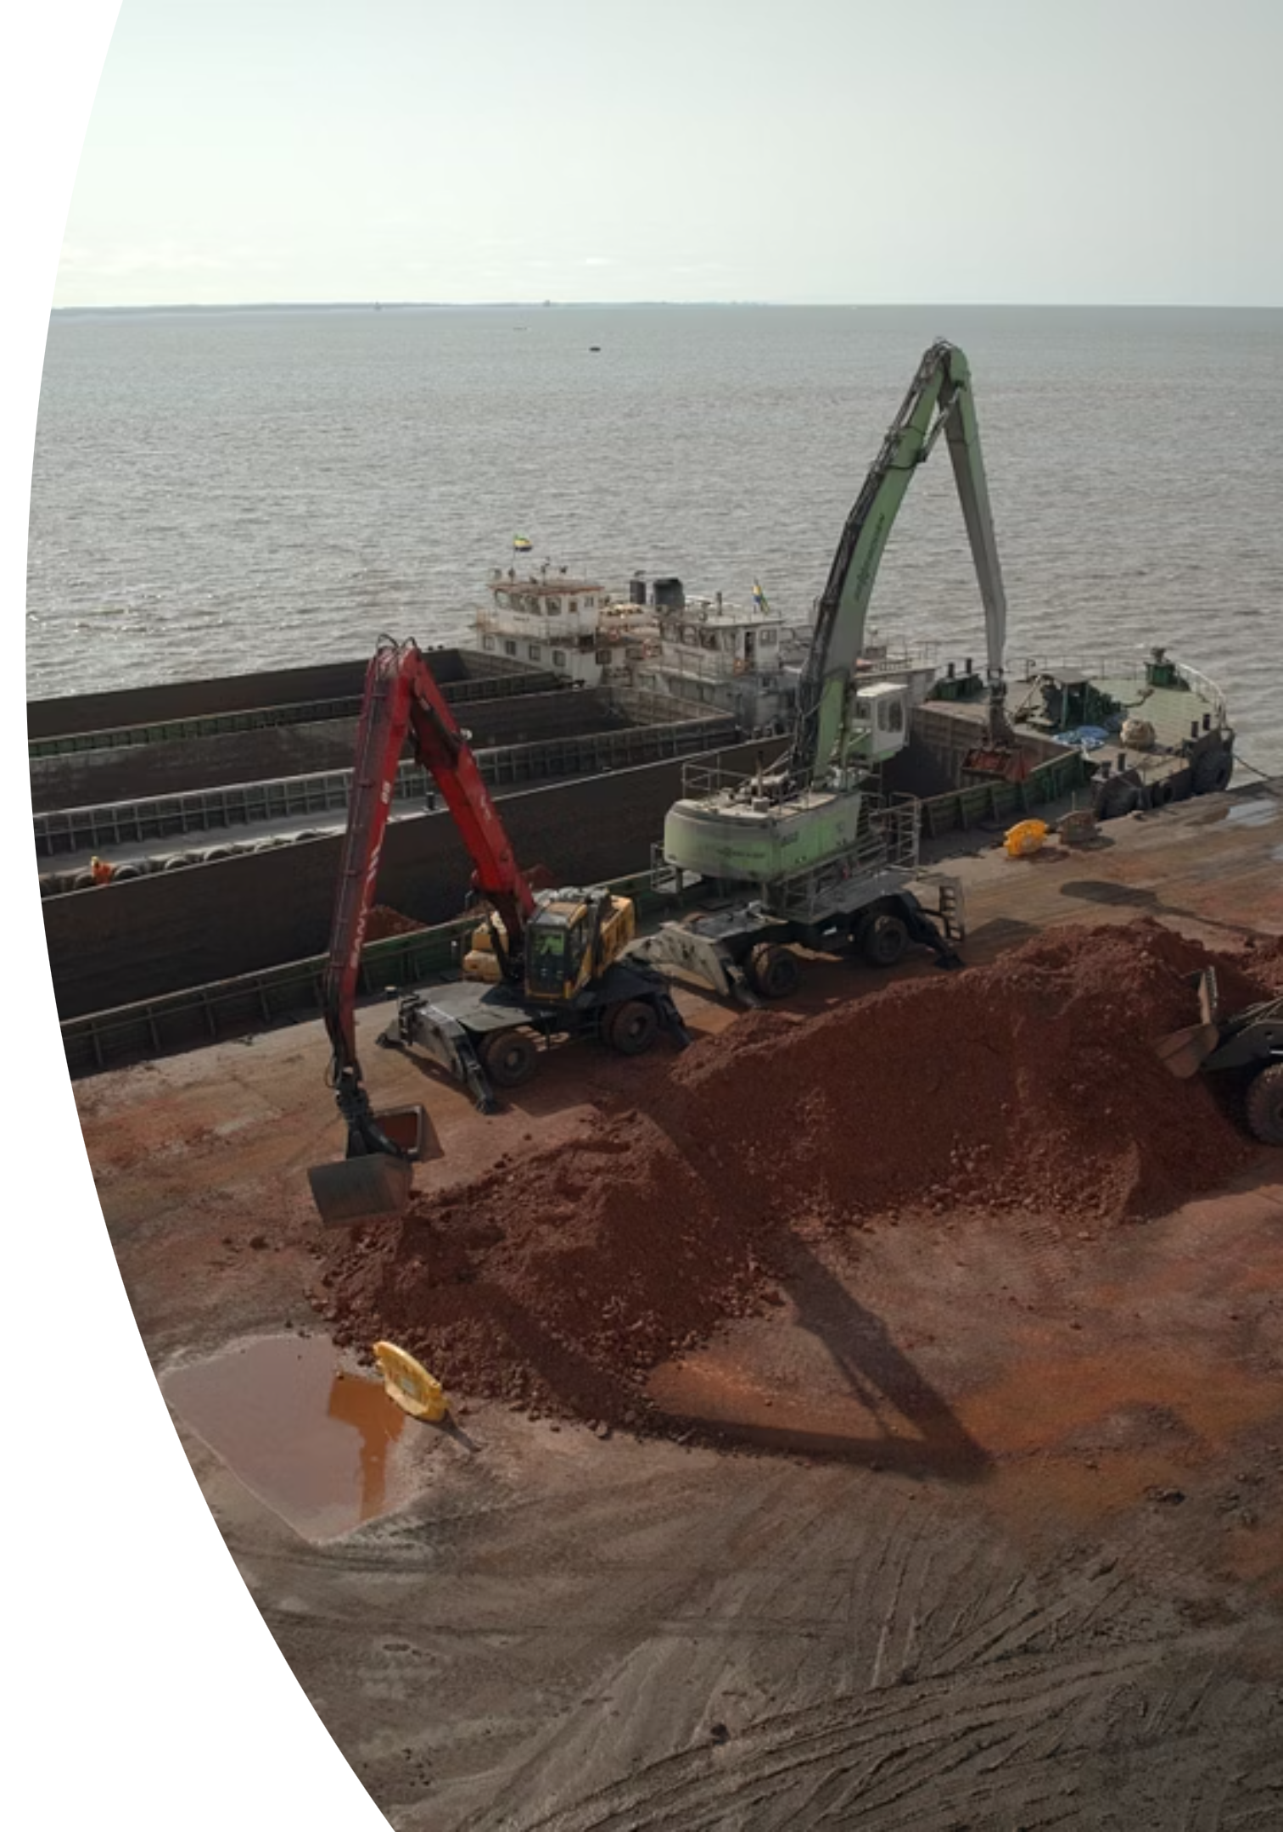
Mining Sector Opportunity: Gabon Market Entry Strategy
Strategic assessment for H.B. Fuller's entry into Gabon's rapidly expanding mining sector

Slide 2
Overview
Strategic Opportunity in a High-Growth Market
Gabon's mining sector is experiencing unprecedented growth, positioned to become a cornerstone of the nation's economy. As the world's third-largest manganese producer, the country is rapidly expanding into iron ore, potash, and gold extraction.
7.5M
$1B+
Tonnes
Revenue
Manganese production in 2024, up 10.7% year-over-year
Manganese export value driving sector growth
With government backing and substantial foreign investment, the sector is projected to grow from 6% to 25% of GDP by 2030. This expansion creates significant demand for industrial solutions that enhance operational efficiency and ensure compliance.
25%
GDP Target
Projected mining contribution by 2030

Slide 3
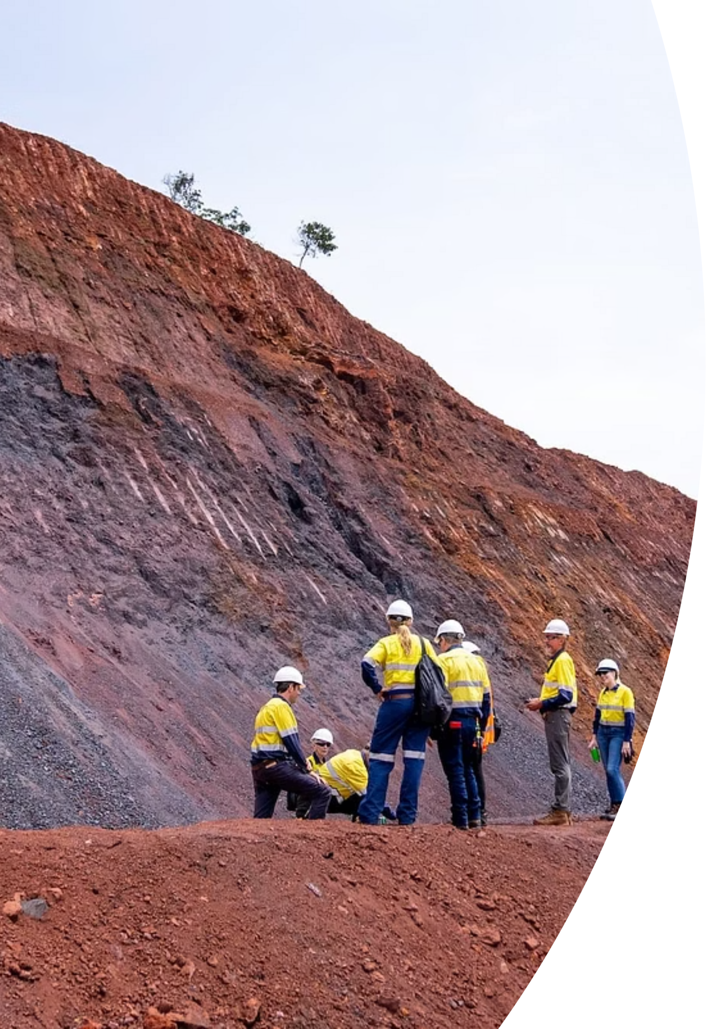
Market Landscape: Minerals & Production
Primary Focus
Growth Sectors
Manganese remains the dominant mineral, critical for steel production and emerging EV battery markets, establishing Gabon as a key global supplier.
Iron ore and potash projects are rapidly scaling, with major investments from international operators driving diversification.
Emerging Resources
Gold, copper, uranium, and bauxite present additional opportunities as exploration and development activities intensify.
Total mineral production reached 15.2 million tonnes in 2024, with Gabon ranking 64th globally. The government's strategic push for sector expansion creates a favorable environment for industrial solution providers.

Slide 4
Key Mining Operators
Strategic targets across large-scale operations and emerging projects
Company/Project
Mineral
Scale
Status
Eramet Comilog (Moanda)
Manganese
Large
Operational
Nouvelle Gabon Mining
Manganese
Large
Operational
Baniaka Iron Ore
Iron ore
Large
Development
Belinga Iron Ore
Iron ore
Large
Development
Banio Potash
Potash
Medium
Advancing
MOIL (India)
Manganese
Medium
Negotiations
Menar (South Africa)
Iron ore
Medium
Negotiations

Slide 5
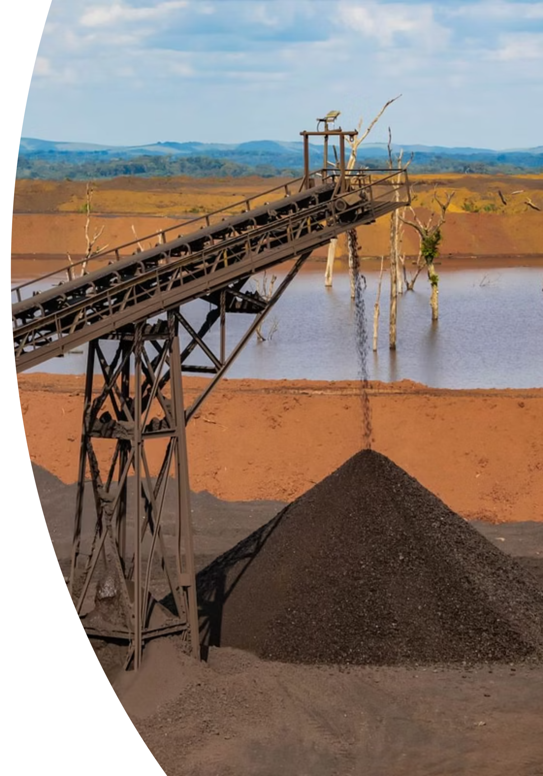
Critical Operational Challenges
Equipment & Maintenance
Heavy wear on machinery, conveyor belt failures, and pipeline leaks lead to costly downtime. Ore processing inefficiencies and frequent maintenance cycles strain operational budgets.
Infrastructure Limitations
Limited energy supply, inadequate railway capacity, and maintenance delays create bottlenecks. Off-grid operations drive up costs and complicate logistics.
Safety & Compliance
Elevated safety risks, particularly in small-scale operations. Robust regulatory framework exists, but inconsistent enforcement creates compliance challenges.
Environmental Pressures
Deforestation, soil degradation, and water pollution demand urgent attention. Companies face increasing pressure to meet environmental and local content regulations.

Slide 6
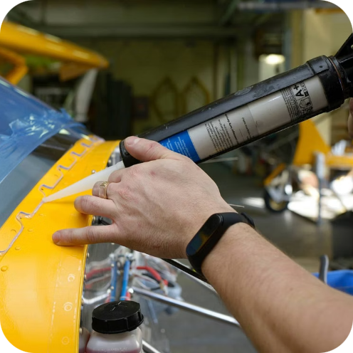

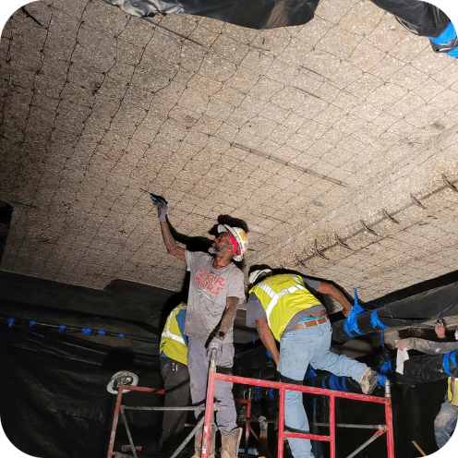


H.B. Fuller Solution Portfolio
Comprehensive industrial solutions addressing critical mining challenges
Industrial Adhesives
Sealants
Epoxies
Protective Coatings
Reduce downtime and extend asset life through advanced bonding solutions for equipment wear and conveyor belt repair.
Prevent leaks and improve safety with high-performance sealing solutions for pipelines and critical equipment.
Lower maintenance costs through structural repair and bonding solutions designed for extreme conditions.
Enhance compliance and reduce asset loss by protecting against corrosion and environmental exposure.
Specialty Chemicals
Improve efficiency and reduce waste in ore processing and equipment cleaning operations.

Slide 7
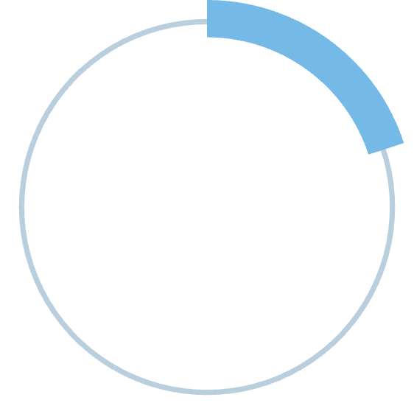
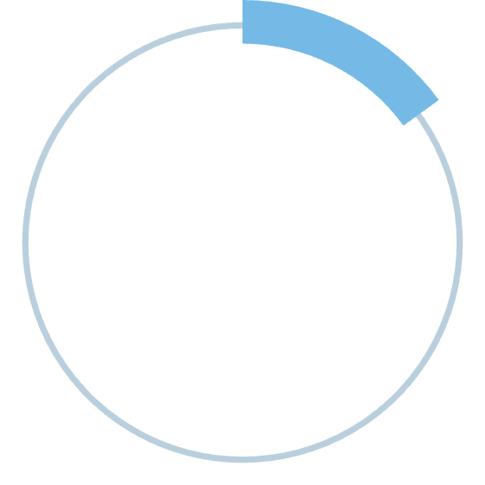
Measurable Client Value
H.B. Fuller solutions deliver quantifiable ROI through reduced operational costs, extended asset lifecycles, and improved safety compliance.
Our technical support includes tailored demonstrations, implementation consulting, and ongoing training to ensure optimal performance in demanding mining environments.
20-30%
15-25%
Downtime Reduction
Maintenance Savings
Minimize production losses through preventive maintenance
Lower recurring costs with durable solutions
20-40%
Asset Life Extension
Maximize equipment investment value

Slide 8



Target Client Segments
Large Mining Operators
Medium-Sized Operators
Service Providers
Priority targets: Eramet Comilog, Nouvelle Gabon Mining
Targets: Banio Potash, MOIL, Menar
Targets: Equipment suppliers, logistics, contractors
Decision-makers: Procurement, Maintenance Managers
Decision-makers: Procurement, Operations, Maintenance Directors
Decision-makers: Procurement, Operations Teams
Opportunity: Growing operations, expansion projects
Opportunity: High-volume contracts, strategic partnerships
Opportunity: Recurring supply agreements

Slide 9
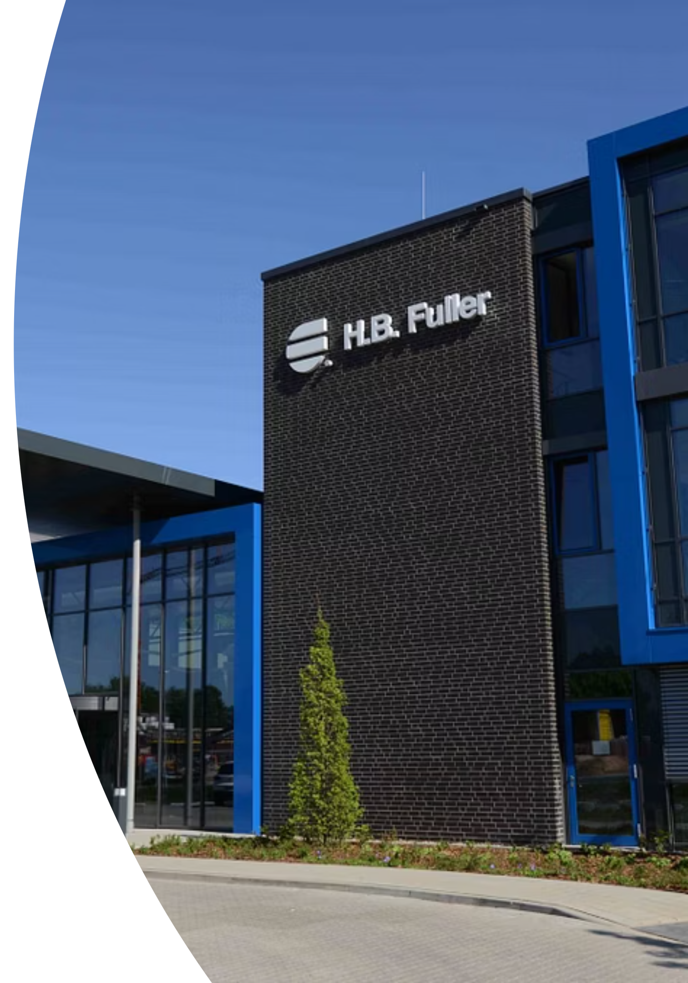
Competitive Differentiation
Market Competition
H.B. Fuller Advantages
Global expertise with local technical support capabilities
Local & Regional Players
Strengths: Local presence, competitive pricing
Customized solutions tailored to mining-specific challenges
Superior durability and performance in extreme conditions
International Competitors
Comprehensive training and implementation consulting
Strengths: Global scale, established reputation
Compliance support for environmental and safety standards

Slide 10
Strategic Roadmap for Market Entry
01
02
03
Targeted Outreach
Pilot Projects
Value Proposition
Engage procurement, operations, and maintenance leaders at priority mining operators. Leverage existing networks and industry connections.
Offer technical demonstrations and proof-of-concept trials. Focus on high-impact applications with measurable ROI.
Present ROI-focused proposals emphasizing downtime reduction, maintenance savings, and asset life extension.
04
05
Strategic Partnerships
Ongoing Support
Establish long-term supply agreements and preventive maintenance programs. Develop customized solution packages.
Provide continuous technical training, compliance consulting, and performance optimization to ensure client success.
Recommendation: Immediate action to secure pilot projects with Eramet Comilog and Nouvelle Gabon Mining will establish market presence and demonstrate competitive advantage in Gabon's high-growth mining sector.

